Slide 1


EVERYBODY HAS SOMETHING TO TEACH AND SOMETHING TO LEARN

Slide 2

THE PROBLEM
Supplemental skills regarded as merely hobbies and valued less than academics rather than as a career aid and an career builder.
Lack of an interactive platform creating a bond between tutor pupil leading to reduced engagement resembling purely a business transaction .
Learning as a community largely missing resulting in massive knowledge and skill gaps within localities with competency in English becoming a barrier for learning.
Underutilization and identification of every Individual's own unique talent and shortfall in providing the resources to develop and nurture those distinctive skills into maturity.

Slide 3
SOLUTION
Increased diversification of Quality content through presence of wide range of instructors in different age groups and expertise allowing them to showcase their uniqueness.
Greater importance given to learning skills beyond academics live through ‘Reciprocal peer tutoring’ known to create better understanding.
Incorporating regional languages in the platform to prevent not knowing English becoming a boundary for learning.
Building a personal connection between the Instructor and the learner leading to a bond of mentorship that builds trust leading to satisfaction on both sides.
Enabling some people in rural areas to become first generation consumers of online information promoting easier access to grasp evolving technologies in areas such as Agriculture, Business and related areas.
Creating value through Community based approach in which everyone’s expertise is utilized especially in case of Retirees and Homemakers whose skills are especially ignored.

Slide 4
CORE FEATURES
RECOGNITION
PLATFORM
PEER BASED MENTORING
TALENT IDENTIFICATION AND MATURATION
FREE CONTENT UPTO BASICS
EXTREMELY
EASY
ONBOARDING

Slide 5
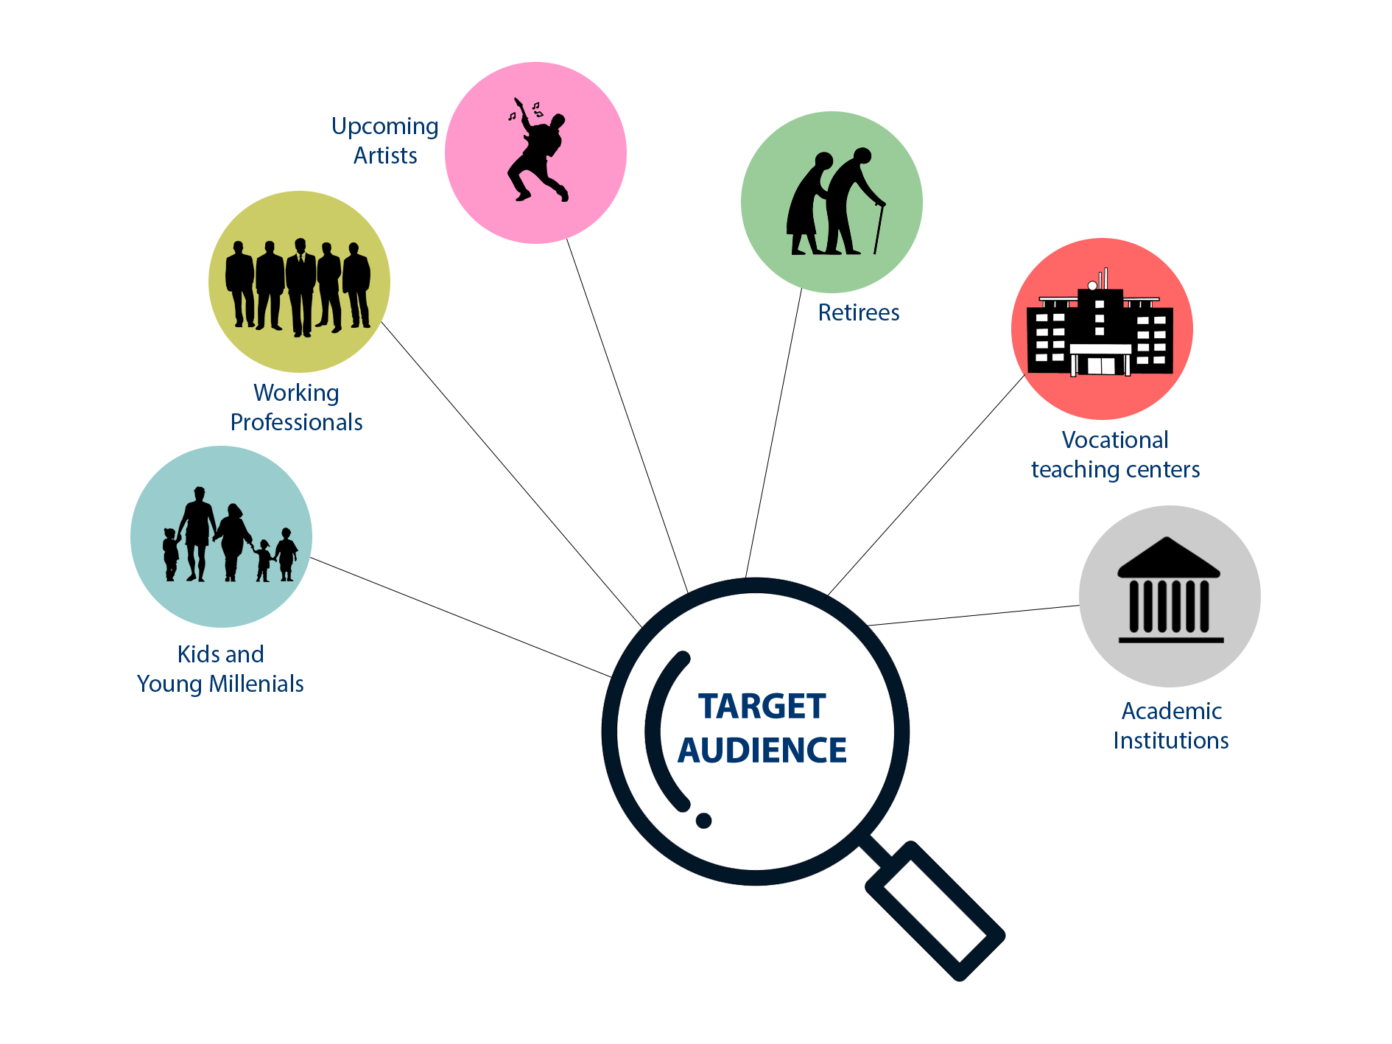
TARGET AUDIENCE

Slide 6
MARKET SIZE
Indian student population: 330 million approx
Total workforce in India : 470 million
Workforce with online presence and needs upskilling/ Reskilling : 180 million approx
Population of skilled Retirees and Homemakers : 20 million
Assuming a market penetration of 70 percent the
Total Addressable market (TAM): 570 million people.

Slide 7
GO TO MARKET STRATEGY
Riding the wave of people’s inclination towards e- learning due to the unfortunate Coronavirus crisis.
Recognising the increasing user base of internet users in Tier II, Tier III and offering the portal in various regional languages by going there in person.
Strategic partnerships with established vocational academies increasing their online presence.
Acquiring sponsorships through gaining exposure in edu-events and across different talent competitions.

Slide 8
BUSINESS MODEL
Adopting a Community-based model - Deeper customer involvement, User Experience, Tailor our services based on emerging customer trends easily.
Revenue primarily achieved through:
Commissions on each paid class taken by the student charging 10-15% much less than the Industry standard 20-35%.
Indirect revenue through using a points system based on content addition by members resulting in greater time spent in our platform.
Focused Content Advertising for specific groups and localities based upon activity and making the advertising space integrated into the content.
Acquiring data from the users that can save as a vital input for business analytics and Big Data. Earning money ethically.

Slide 9
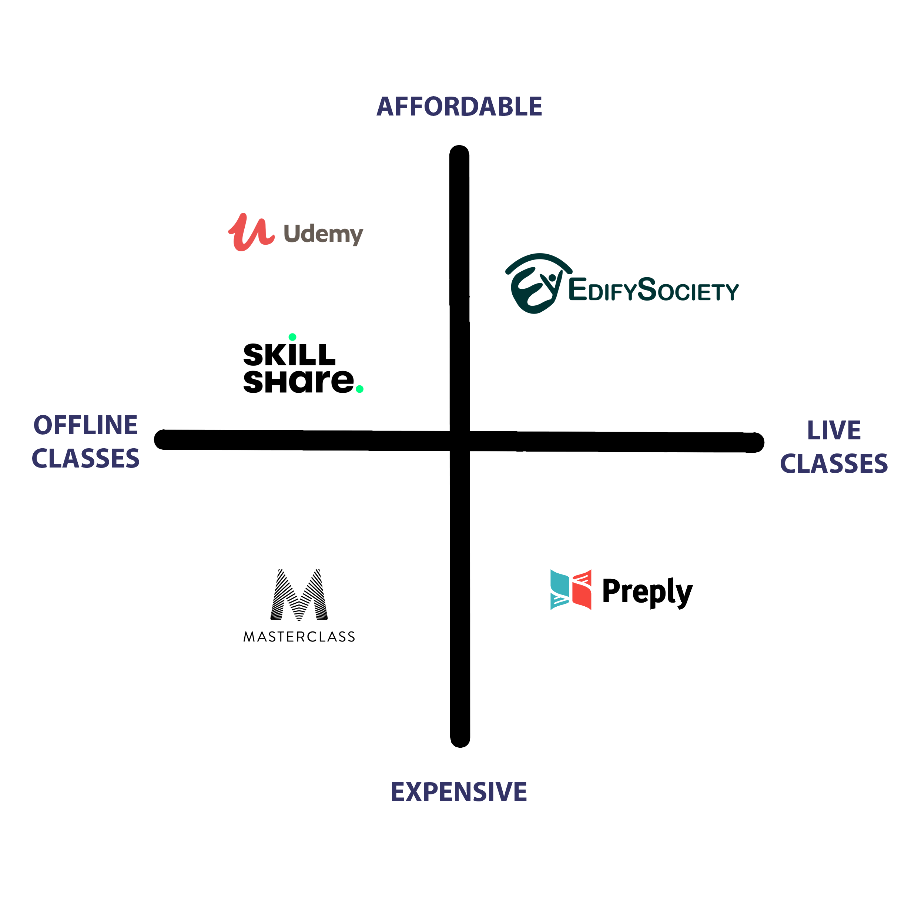
COMPETITIVE LANDSCAPE

Slide 10
UNIQUE ADVANTAGES
First to Market content platform for interactive live learning of non-academic skills.
Utilizing a community based approach enabling people with similar interests to form a Social Network of knowledge sharing resulting in loyal customer base due to deeper customer engagement
Setting a trailblazer initiative to give an opportunity for people to showcase their talent earning deserved recognition and feedback also motivating others by creating challenges, events expanding the limits of a learning platform.
Massive user base due to the inclusion of people of all ages from all walks of life occupying a dual role with teaching their expertise and learning a skill of their liking.

Slide 11
THE TEAM
SARAVANAN S - The Dreamer, Opportunist, Strategist, Pathfinder
NAVEEN KUMAR N - The Realist, Thinker, Programmer, Planner

